Slide 1
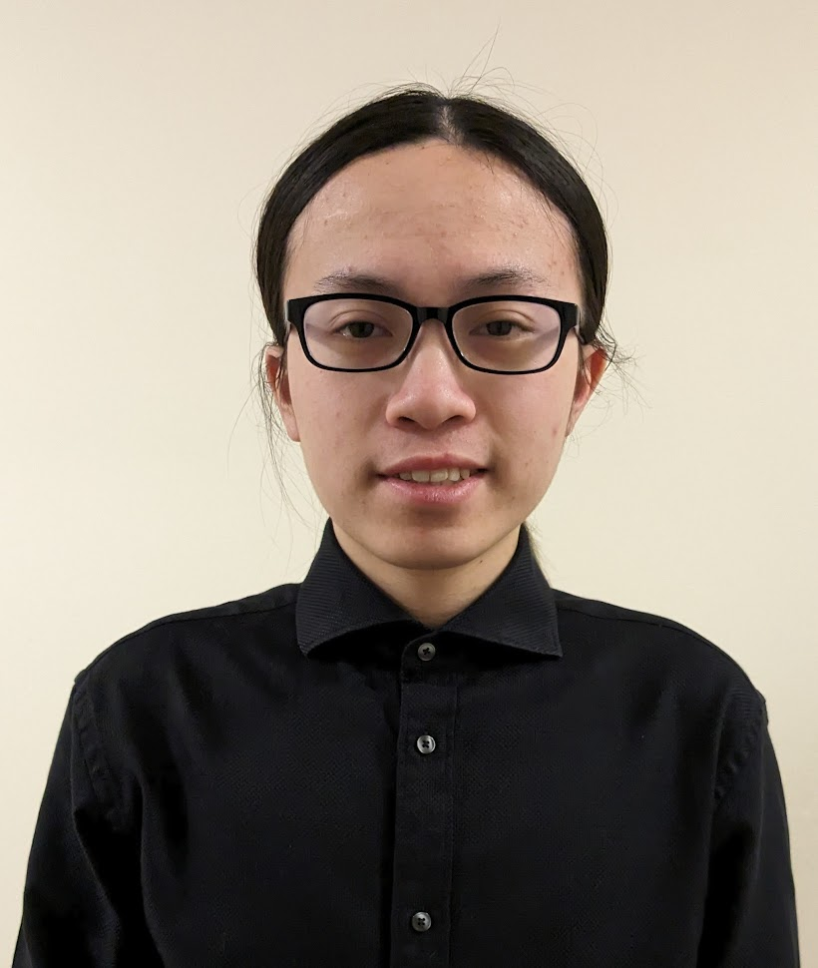
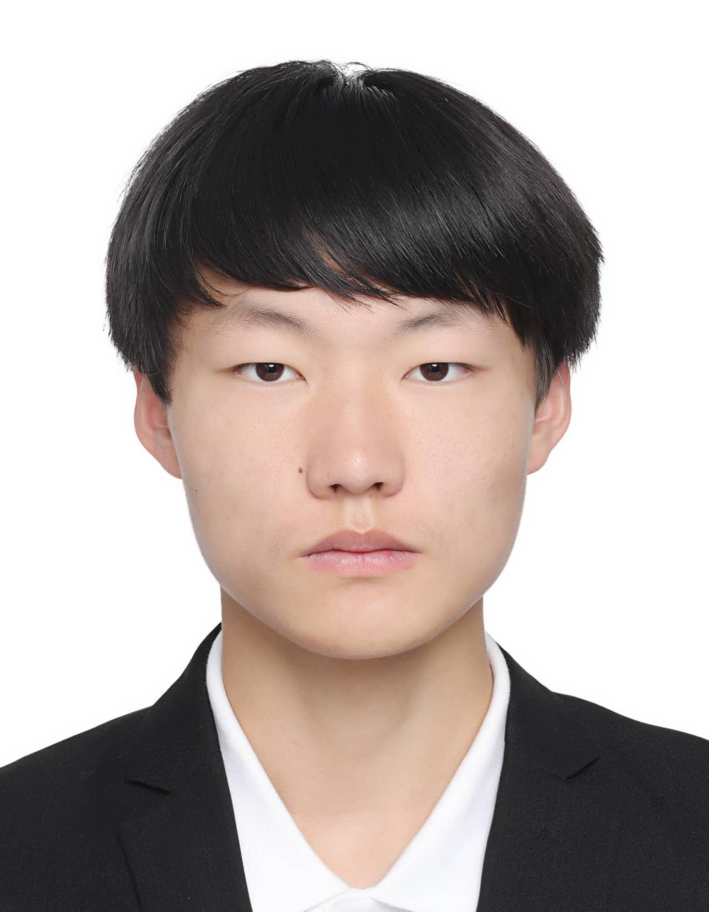
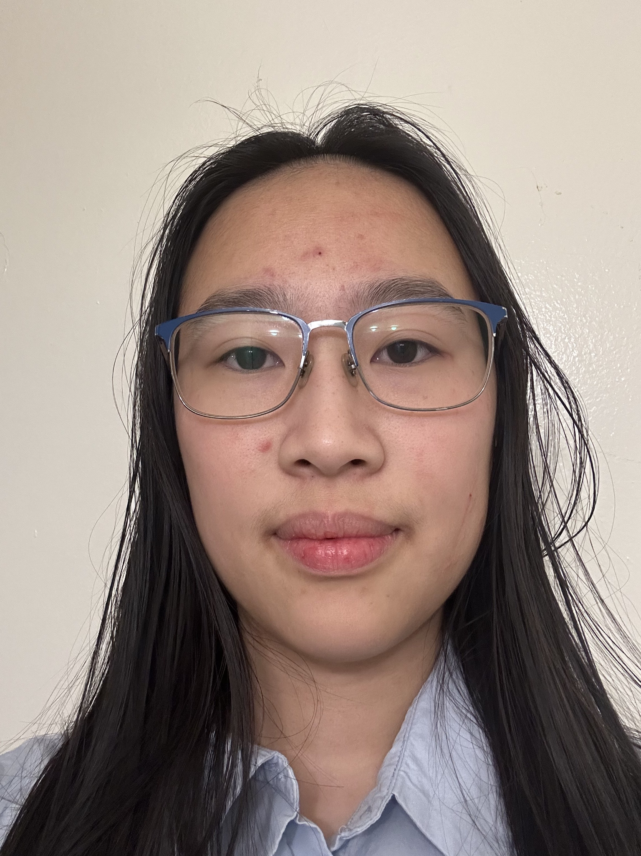
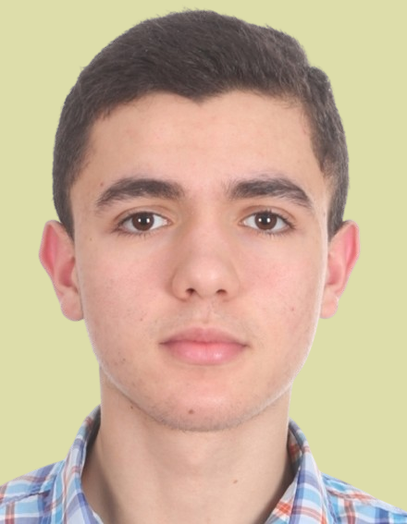
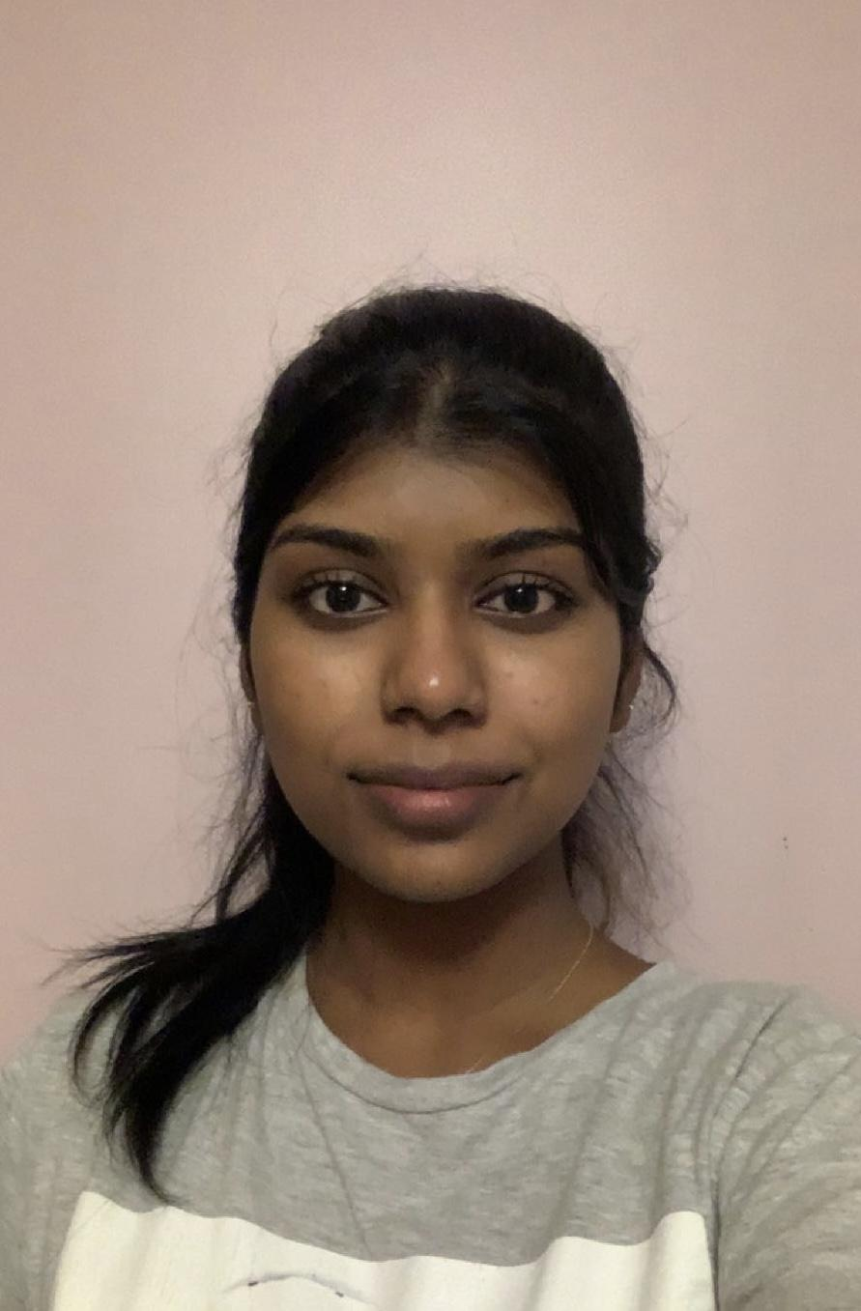
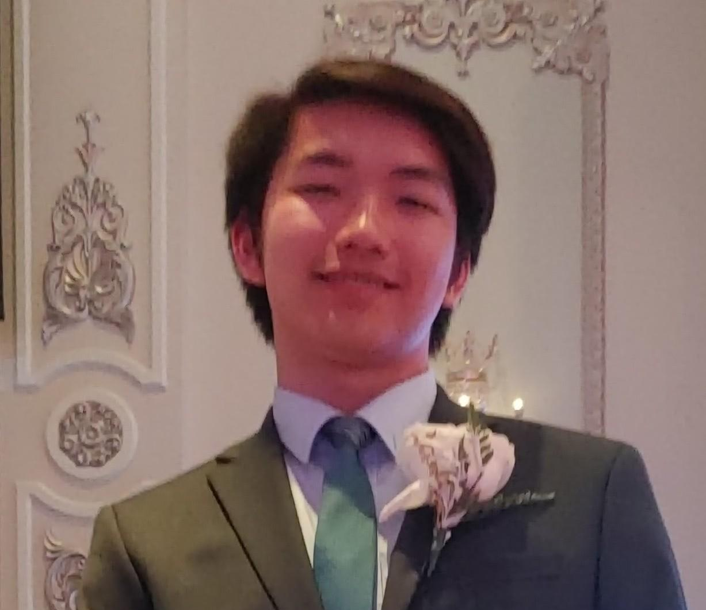
CHESTNUT RESIDENCE
Wellness Room Expansion 2024/03/13
Team Leader
Warrick Tsui
Project Manager
Yongkang (Ken) Cheng
Lead Editor
Aileen Sun
Team 121
TUT 125
Formatter
Youssef Bayoudh
Communication Liaison
Akshaya Velmurugan
Research Analyst
Ethan Lam
Design Review Gateway
1
Notes:
1 Slide
Cover Slide
and Team Introduction
oDate of presentation
oTeam member pictures and names
oTeam number

Slide 2
Disclaimer
This design has been prepared by first year engineering and architect students at the University of Toronto and does not present a Professional Engineering or Architecture design. A Professional Engineer or Architect has not reviewed this presentation for technical accuracy or adequacy. The recommendations of this design may not be implemented in any way unless reviewed and approved by a licensed Professional Engineer or Architect where such review and approval is required by professional or legal standards, it being understood that it is the responsibility of the recipient of the design to assess whether such a requirement exists.​
The Presentation may not be reproduced, in whole or in part, without this Disclaimer.
© Engineering Strategies and Practice, University of Toronto, 2024
Permission to reproduce material from this presentation may be requested by email to your team’s contact person, with a CC to Engineering Strategies and Practice at esp@engineering.utoronto.ca

Slide 3

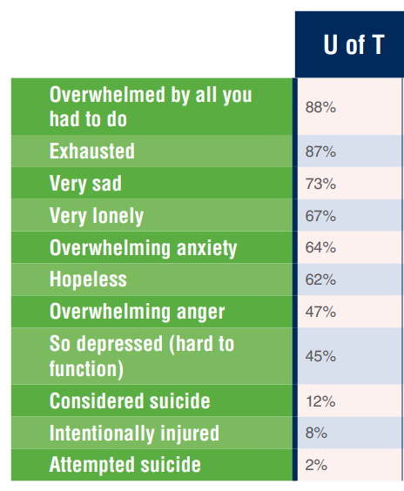
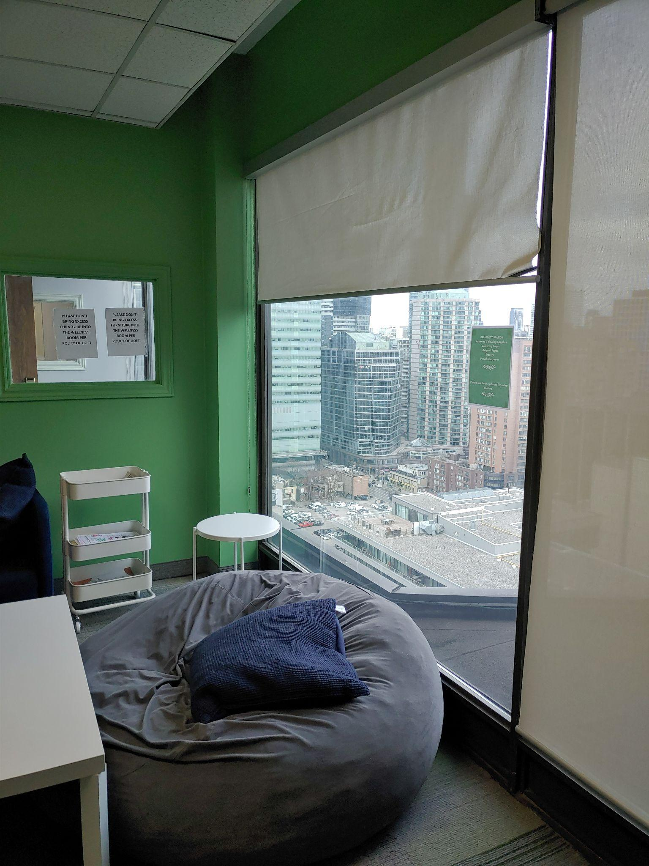
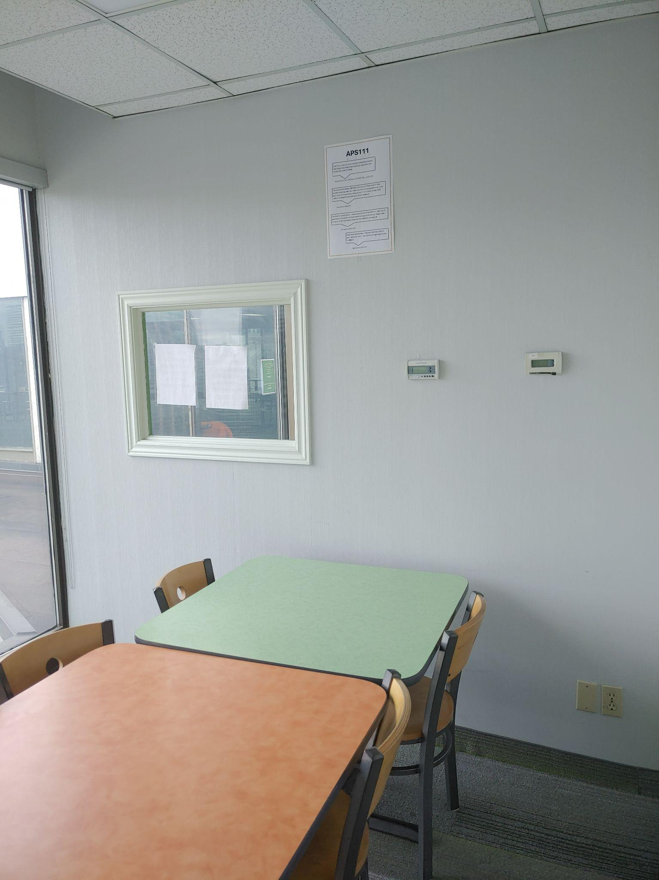
Ethan Lam
Project Review and Significance
Project: Wellness Room Expansion
Client: Lucy Chandler
(Chestnut Residence Life Coordinator)
2017 Survey
Wellness Room
Study Room
2

Slide 4
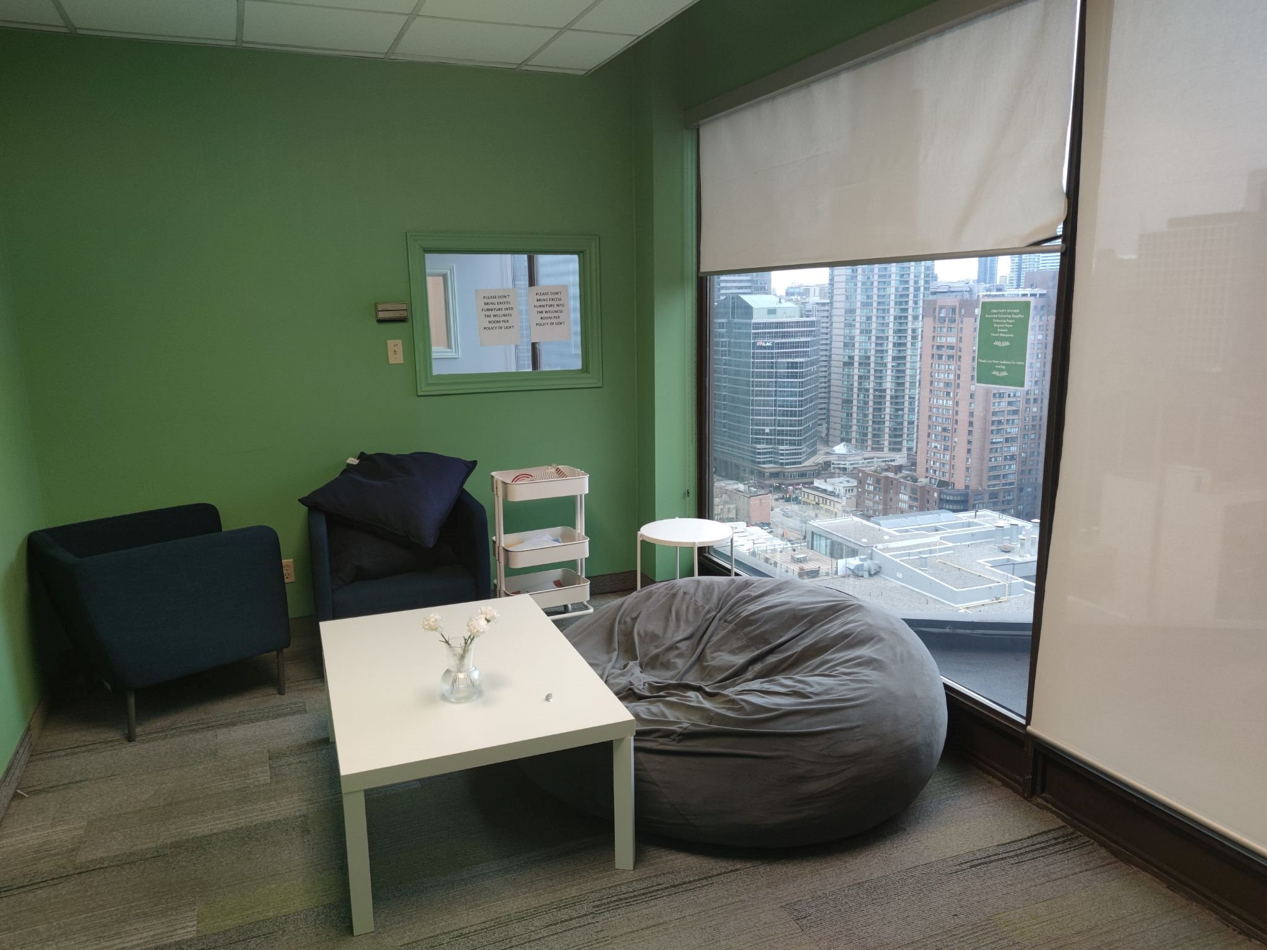
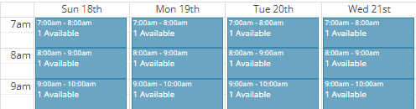
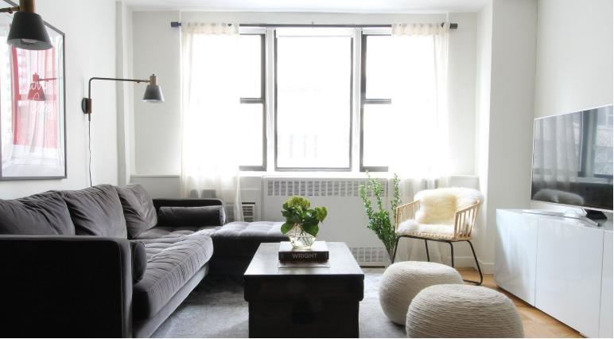
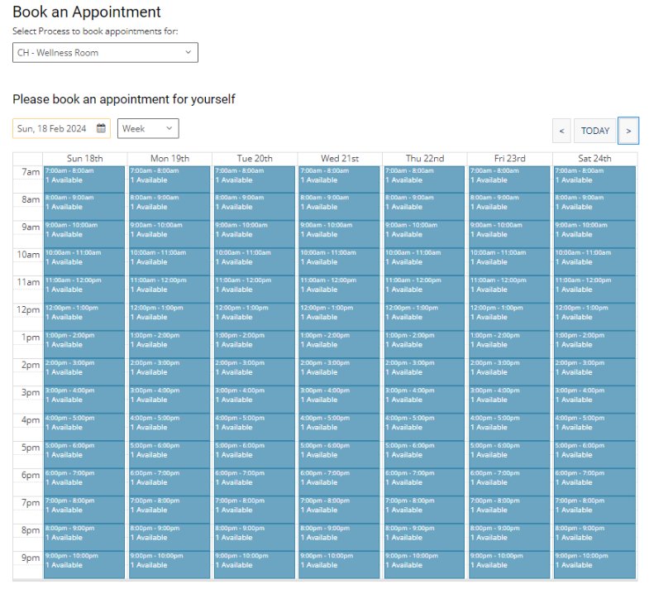
Youssef Bayoudh
Project Review
Wellness room
Standard living room
Screenshot showing the booking page of the wellness room
3
Notes:
https://www.google.com/url?sa=i&url=https%3A%2F%2Fwww.thespruce.com%2Faverage-living-room-size-7975270&psig=AOvVaw1fs2_jqGwIFLtQfe0GvyvE&ust=1710371911051000&source=images&cd=vfe&opi=89978449&ved=0CBUQjhxqFwoTCPCLroPu74QDFQAAAAAdAAAAABAE

Slide 5


Aileen Sun
Client Meeting #2: Revisions
made to FOCs
PR Review
Obstacle - Objectives and Constraints not actionable for idea generation
Overcoming
Move less critical FOCs to appendix
New objectives and constraints
Client Meet
Questions answered
[in green]
Blood level?
Building Code
Objective | Metric
Incorporate [five] different forms of media communicating wellness information | Forms of media
Constraint | Metric
[Weekly] maximum maintenance frequency need | Number of days
4
Notes:
3rd slide for project status of need

Slide 6

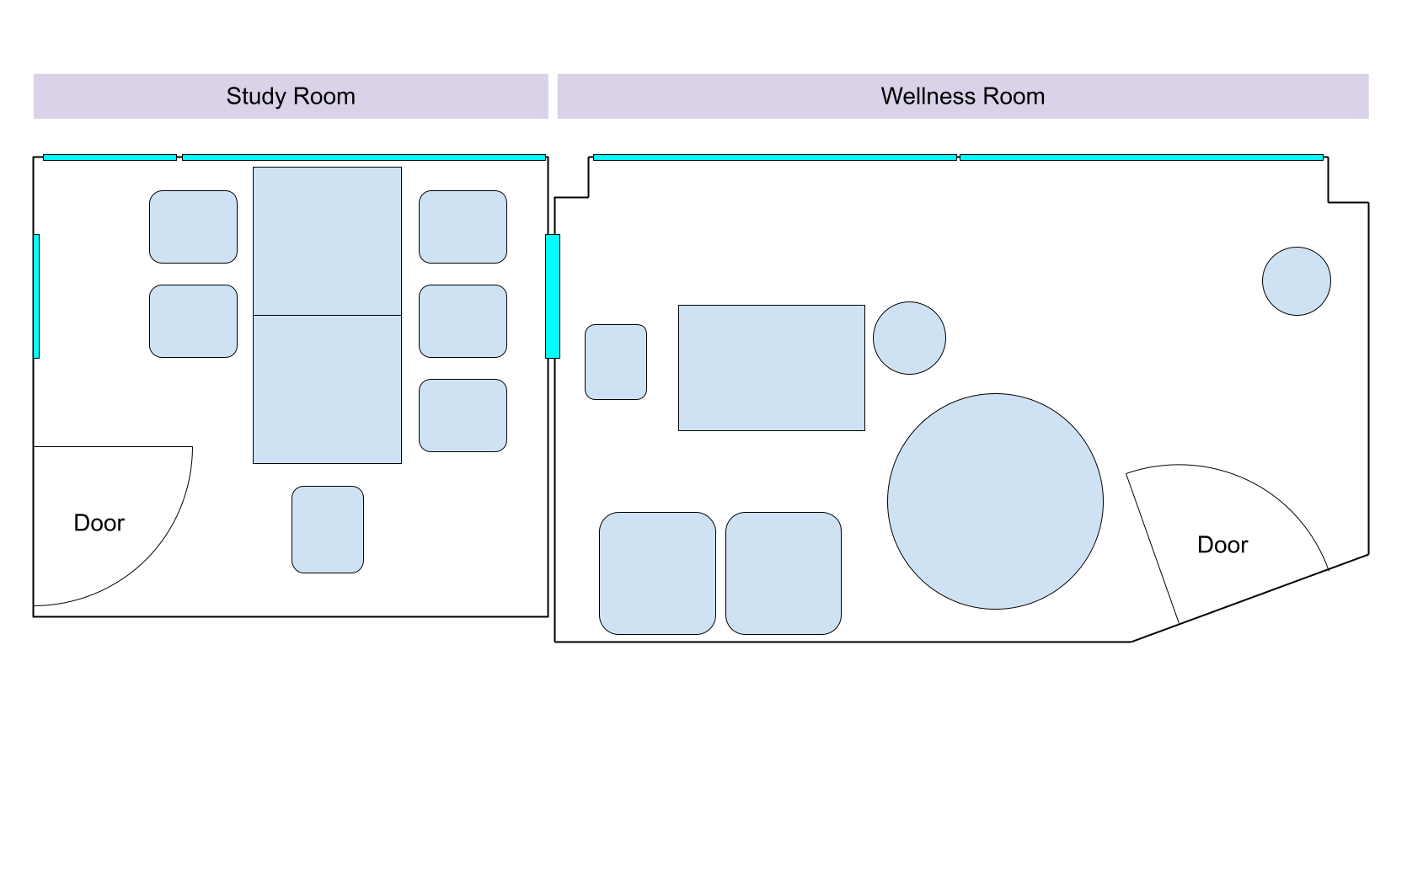
Akshaya Velmurugan
Client Meeting #2 Overview
Review of Meeting
Lucy Chandler’s Insights
Limitations
Expectations
Key points
>=10 different mentally stimulating
resources
Increase of 50% in use
Wall in between rooms can stay
Impact
Measures of success
Expansion of idea generation space
5
Notes:
1-2 Slides – Client Meeting #2–PR Review
o Review of Client Meeting
went over key points of pr making sure there was clear communication from both parties of what the project goal is
o Client feedback
o Revisions since client meeting

Slide 7


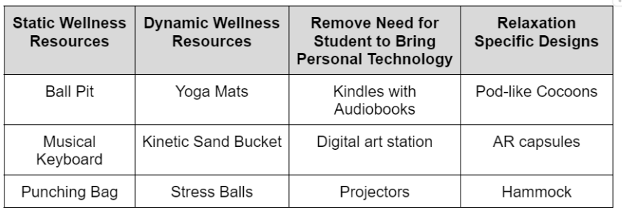





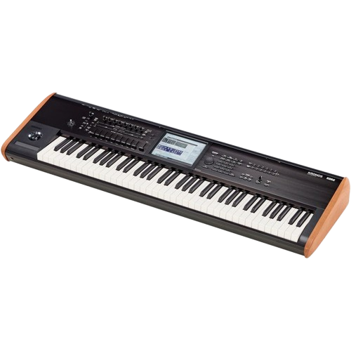


Ethan Lam
Project Status: Idea Generation
Exploring design space while incorporating client feedback through a systematic process
77 Components
6

Slide 8
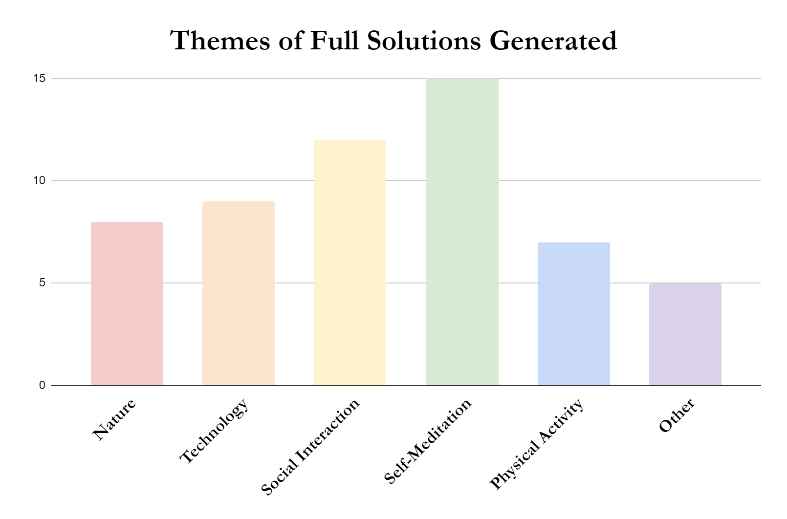
Warrick Tsui
Project Status: Ideation Progress
Individual Idea Generation: 77 Components
Full Solution Generation: 56 Full Solutions
Sample Solution:
Nature-themed solution; escape from technological reality
Wooden Panel Doors
Forest canopy-themed light
Nature sounds
12
15
8
9
7
5
Current Stage
Group Consolidation and Multi-Voting: 10 Full Solutions
7

Slide 9
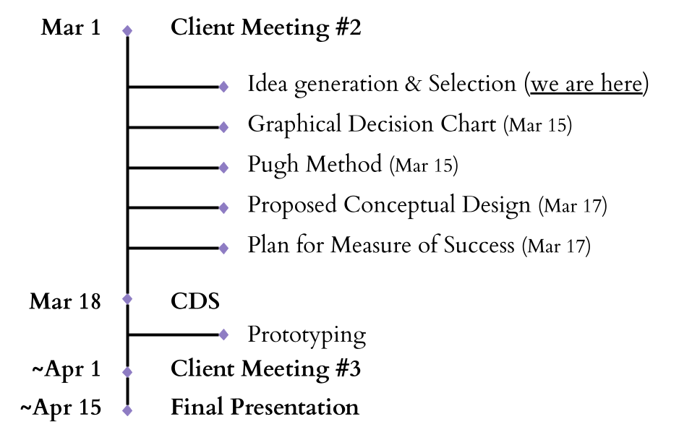
Ken Cheng
Project Status: Milestones and Tasks
8
Notes:
This slide is about subclaim 4

Slide 10
Youssef Bayoudh
Conclusion
Demonstrated thorough understanding of the problem by our team.
Identified and confirmed the needs of our client through communication.
Explored various design possibilities to find solutions that satisfy the client's requirements and project criteria.
9
Notes:
1-3 Slides–Project Status
oThe current stage of the design process
oShort term tasks and next milestone
oLong term milestones
oA project that is on track should
include progress on the ideation process

Slide 11
REFERENCES
[ 1] "Report on Student Health and Well-Being - University of Toronto," University of Toronto Provost. Accessed: February 16, 2024. [Online]. Available: https://www.provost.utoronto.ca/wp-content/uploads/sites/155/2018/03/Report-on-Student-Health-Well-Being.pdf
[2] D. Alayon, "Biomimicry: Innovation Inspired by Nature," Future Today, Accessed: March 12, 2024. [Online]. Available: https://medium.com/future-today/biomimicry-innovation-inspired-by-nature-44825c76a852
[3] "ChatGPT Logo PNG," FreePNGLogo.com. Accessed: March 12, 2024. Available: https://freepnglogo.com/chatgpt-logo-png
[4] "Brainstorming PNG Images," Vecteezy. Accessed: March 12, 2024. Available: https://www.vecteezy.com/free-png/brainstorming
[5] Pinterest. "Pin." Accessed: March 12, 2024. Available: https://www.pinterest.com/pin/stars--345580971390946882/
[6] "Benchmark PNG Images," PNGTree. Accessed: March 12, 2024. Available: https://pngtree.com/free-png-vectors/benchmark
[7] Chestnut Residence - University of Toronto. Accessed: March 12, 2024. Available: https://chestnut.utoronto.ca/
[8] "Product Details," ilovenisvs.live. Accessed: March 12, 2024. Available: https://ilovenisvs.live/product_details/34002079.html
[9] "Custom Logo Stress Ball," Media Monkey Marketing. Accessed: March 12, 2024. Available: https://mediamonkeymarketing.com/product/custom-logo-stress-ball/
[10] "Digital Art Icon," Flaticon. Accessed: March 12, 2024. Available: https://www.flaticon.com/free-icon/digital-art_2006650
[11] "Image," pngimg.com. Accessed: March 12, 2024. Available: https://pngimg.com/image/64082
10
Notes:
References

Slide 12
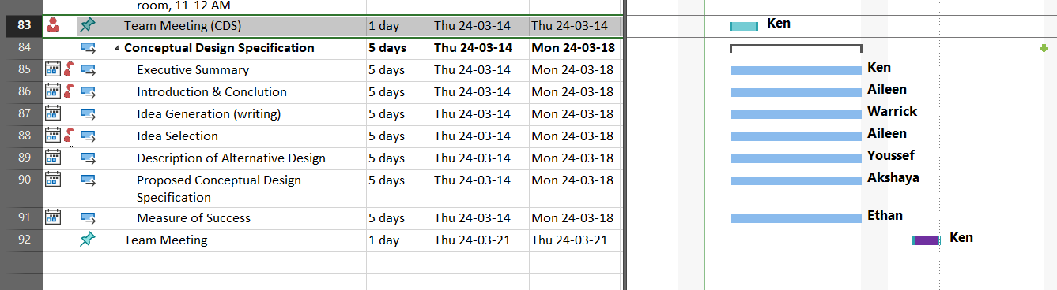
Appendix A: Gantt Chart
Theme
Icons
Categories
11
Notes:
2 Slide if needed– Client Meeting #2–PR Review

Slide 13
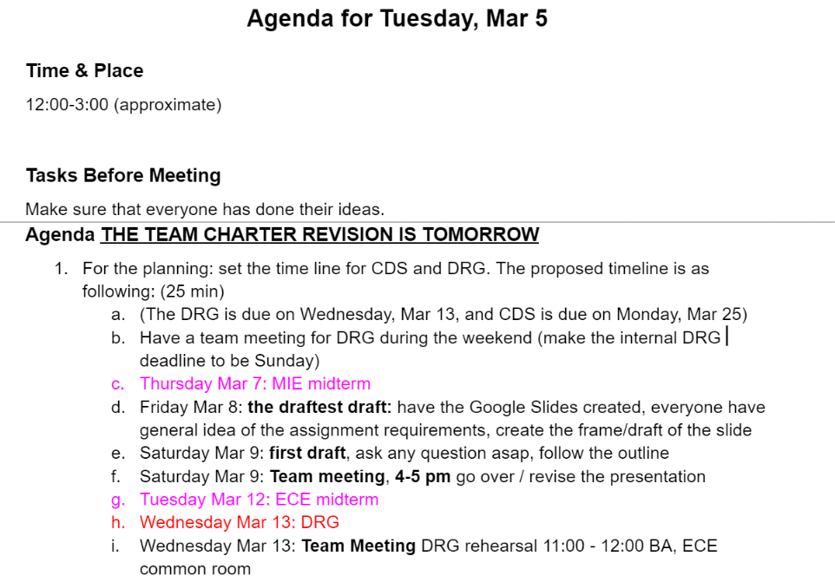
Appendix B: Team Meeting Agenda Example
Theme
Icons
Categories
12
Notes:
2 Slide if needed– Client Meeting #2–PR Review

